Slide 1

CUSTOMER CLUSTERING IN A RETAIL MARKET: DATA DRIVEN APPROACHES
- VIPUL CHALOTRA (280269)
THESIS ADVISORS:
Fabrizio Rossi
Andrea Manno
Stefano Smriglio
December 16, 2023

Slide 2

Table of Contents
Introduction
Exploratory Data Analysis
Customer Clustering Insights
Conclusion

Slide 3
Study Objectives
Retail Industry Trends.
Exploratory Analysis to Uncover Customer Characteristics.
Effective Data-Driven Customer Clustering Methods.
Customer Segmentation Patterns and Characteristics.
Impact of Customer Clustering on Retail Performance Metrics.
Practical Recommendations for Retail Strategy Enhancement.

Slide 4
Table of Contents
Introduction
Exploratory Data Analysis
Customer Clustering Insights
Conclusion

Slide 5

Demographic Analysis
Notes:
Cardholders: 7,950 & 2,600
CAP Data Excluded

Slide 6
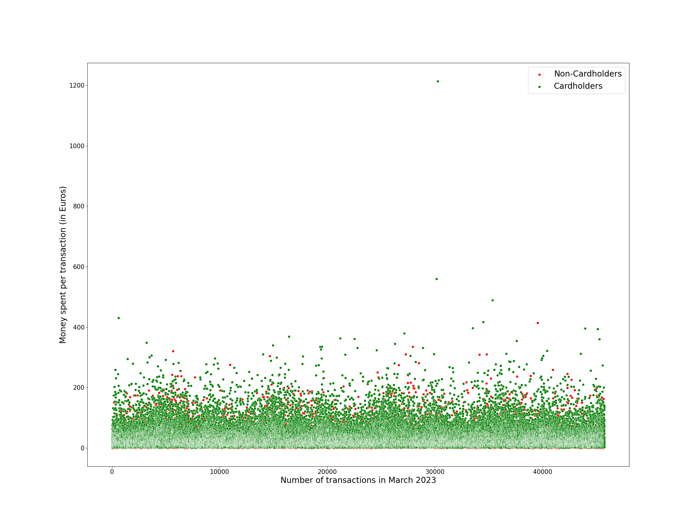
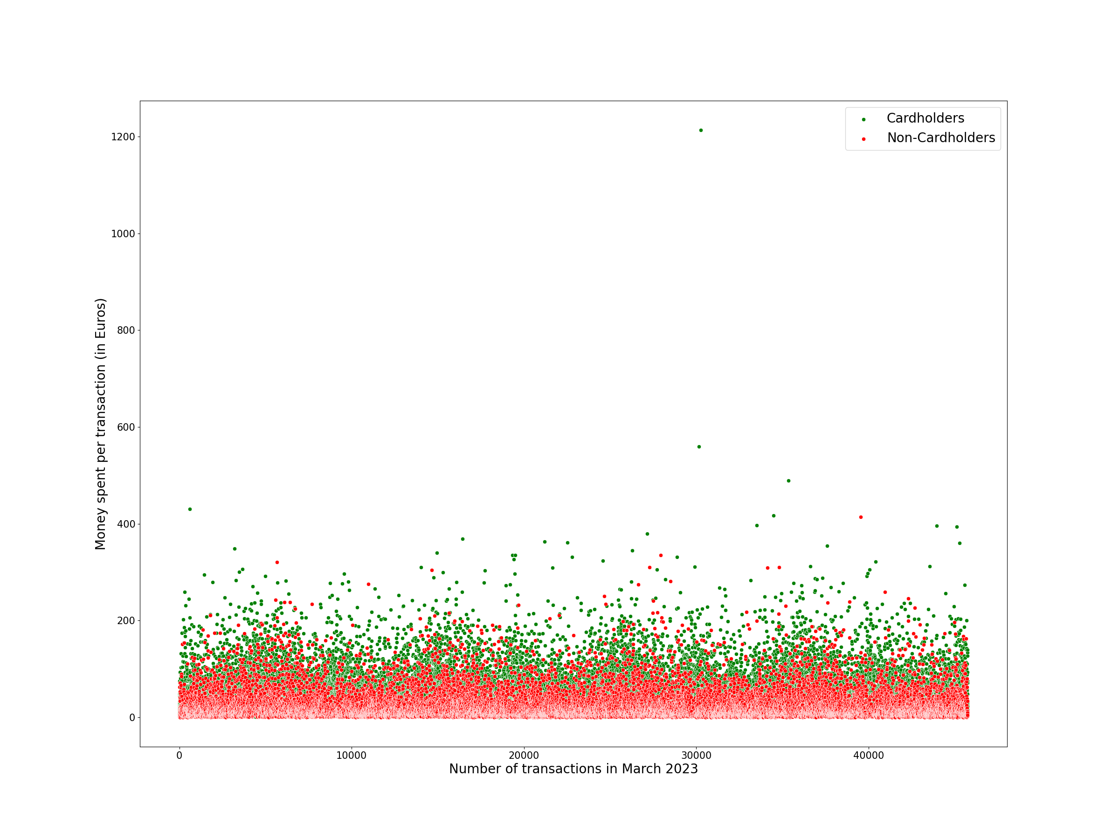
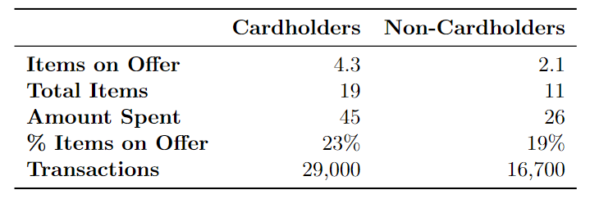
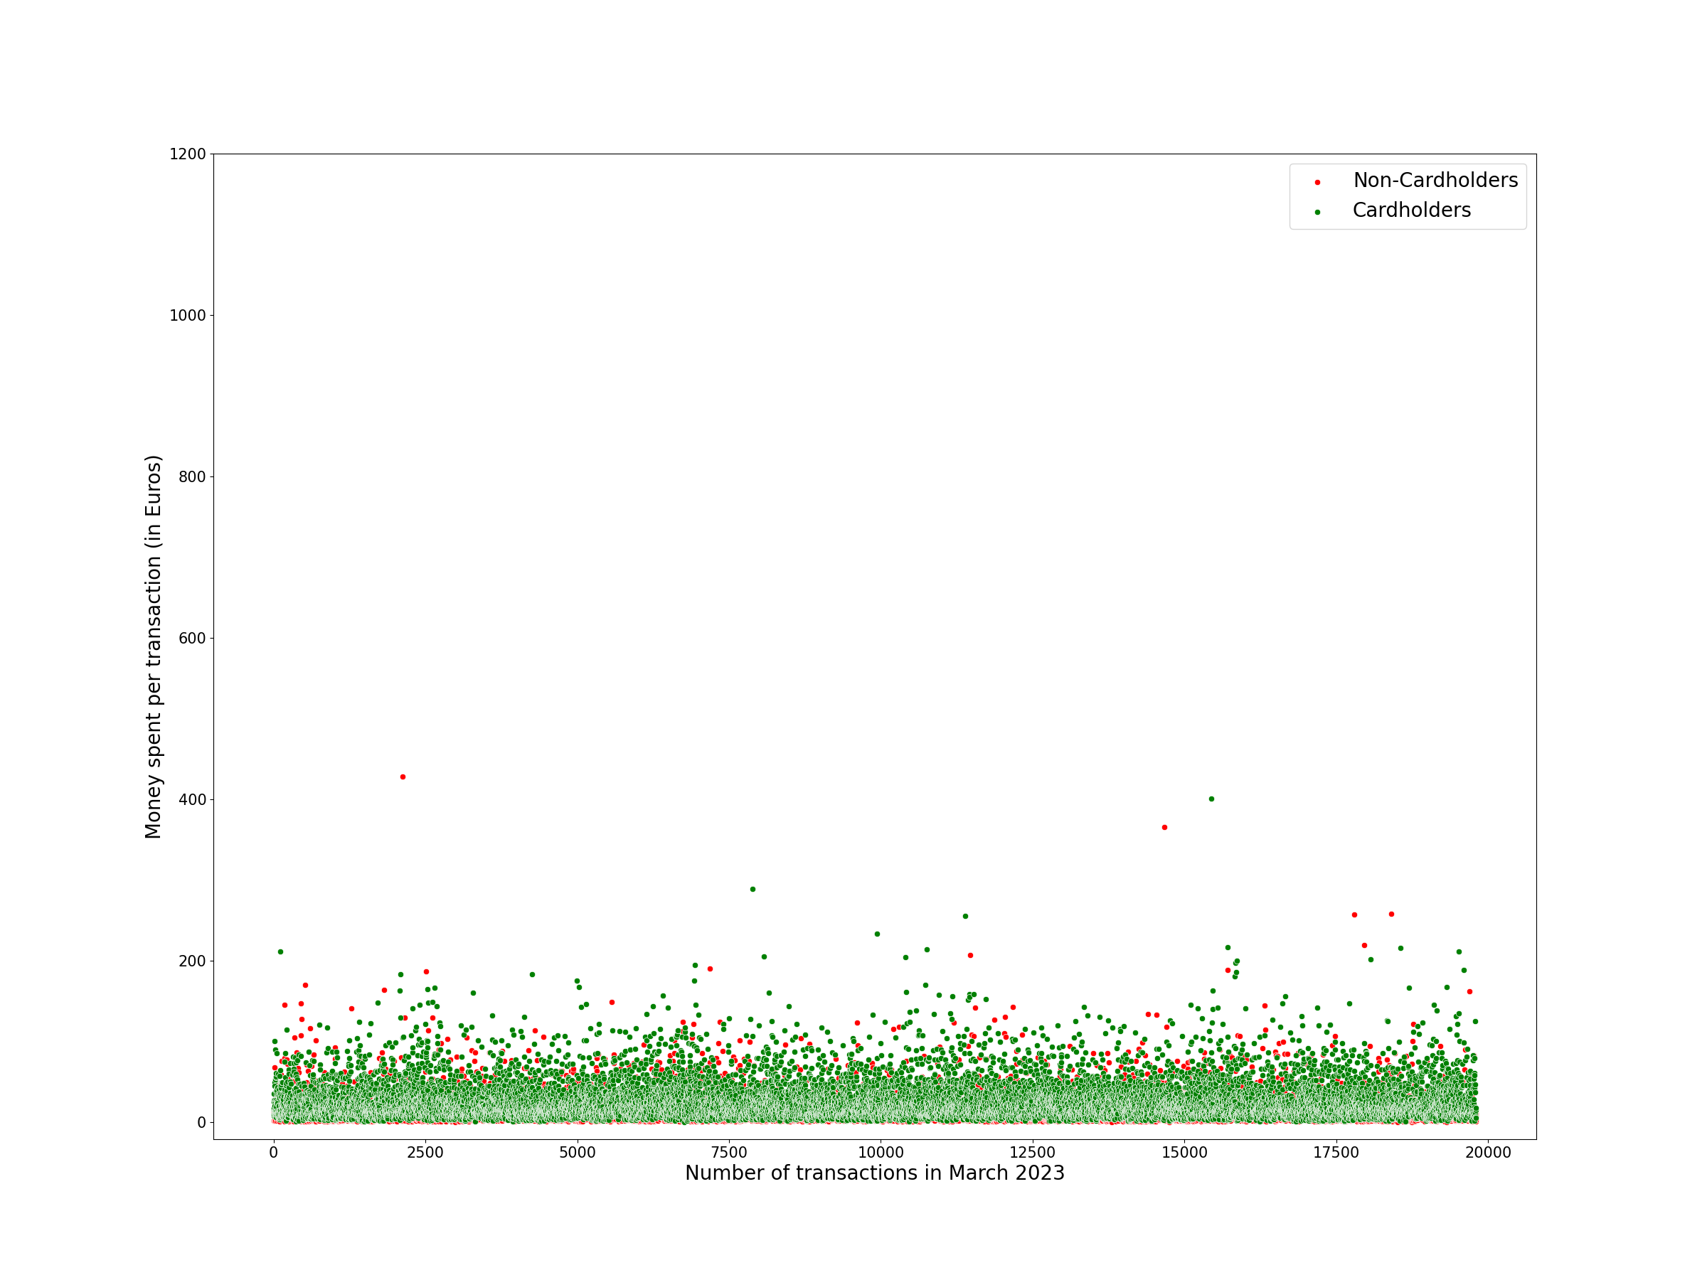
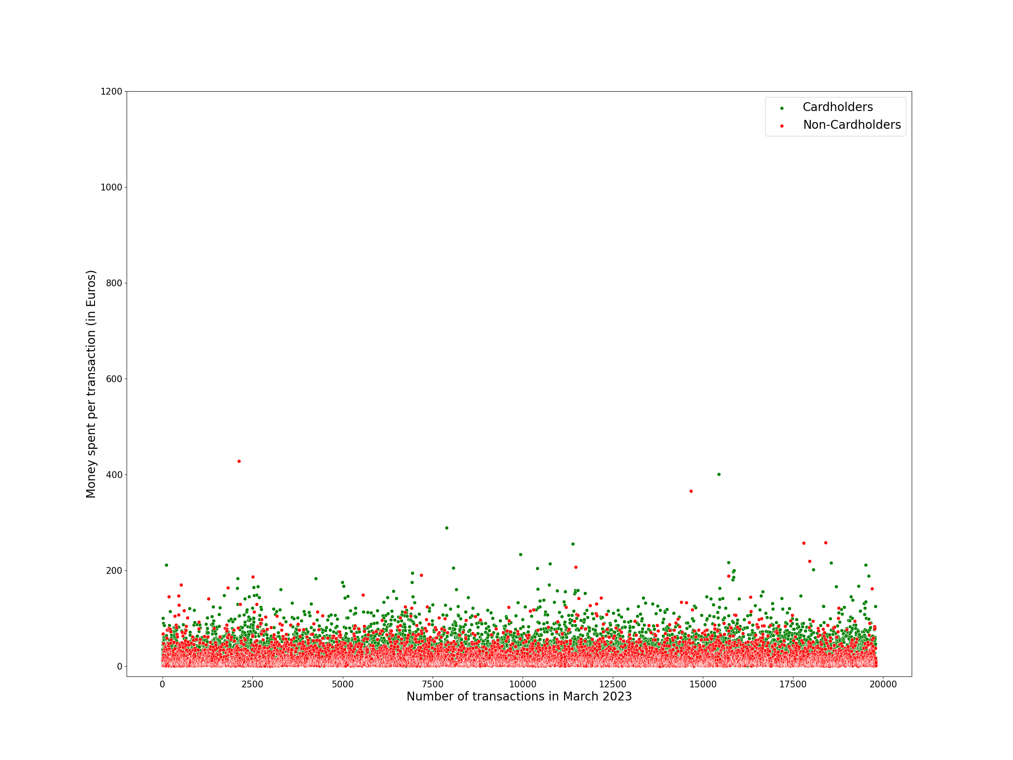
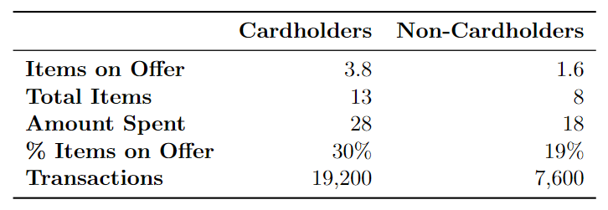
Transactional Analysis
LOCATION 1
LOCATION 2
Notes:
Transactions: 45,700 & 19,800
Location 1 Spearman Coefficients: 0.28, 0.31, 0.31
Location 2 Spearman Coefficients: 0.36, 0.31, 0.31

Slide 7
Item Sector Analysis

Slide 8
Daily Analysis

Slide 9
Hourly Analysis

Slide 10
Table of Contents
Introduction
Exploratory Data Analysis
Customer Clustering Insights
Conclusion

Slide 11
Recency-Frequency-Monetary (RFM)
Customer Base under Investigation: Cardholders
Two Main Parts:
Predefined Segmentation
K-Means Clustering
Predefined Segmentation
10% Recency, 30% Frequency, 60% Monetary
RFM Score on 5 Point Scale
Rank Separation at 1.6, 3.0, 4.0, 4.5
K-Means Clustering into 2 & 4 Clusters

Slide 12
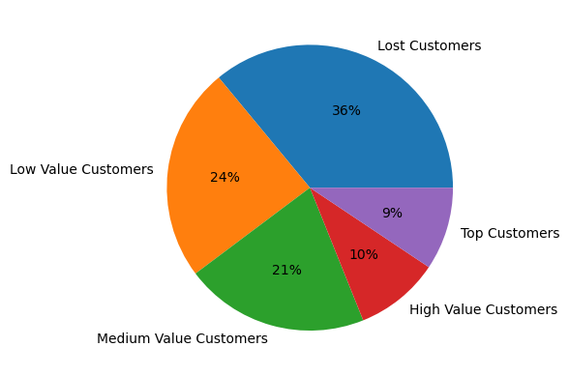
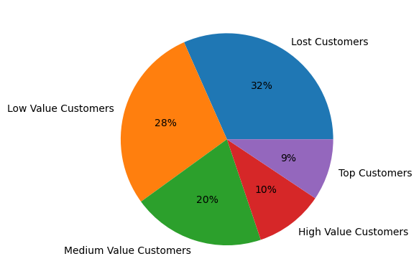
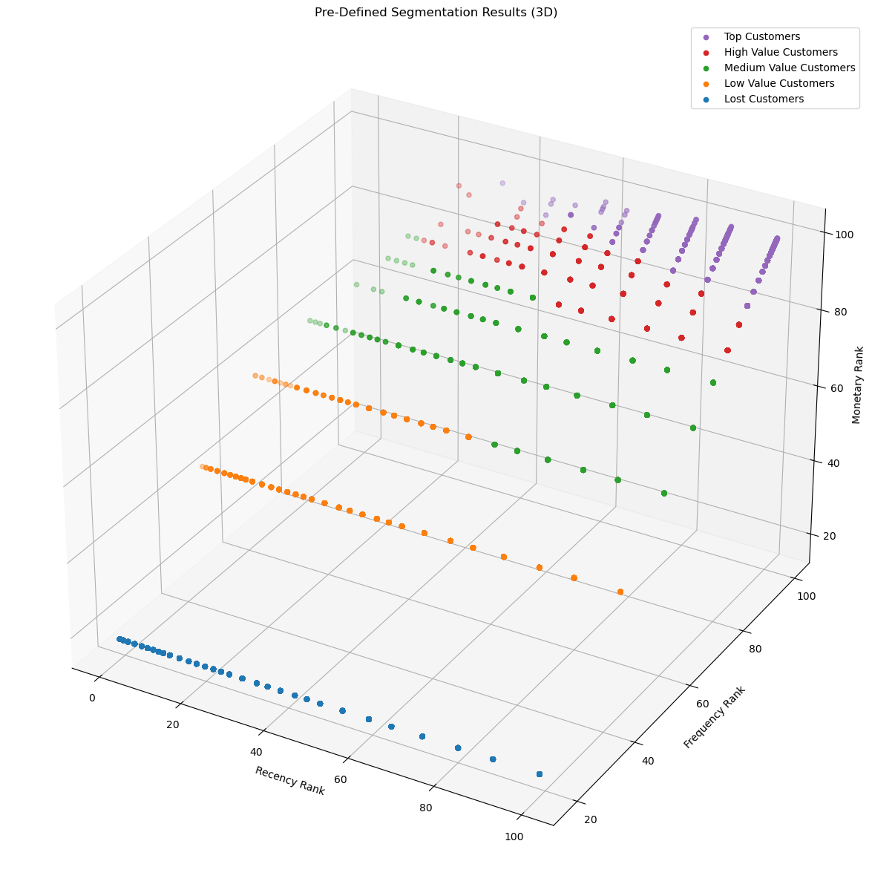
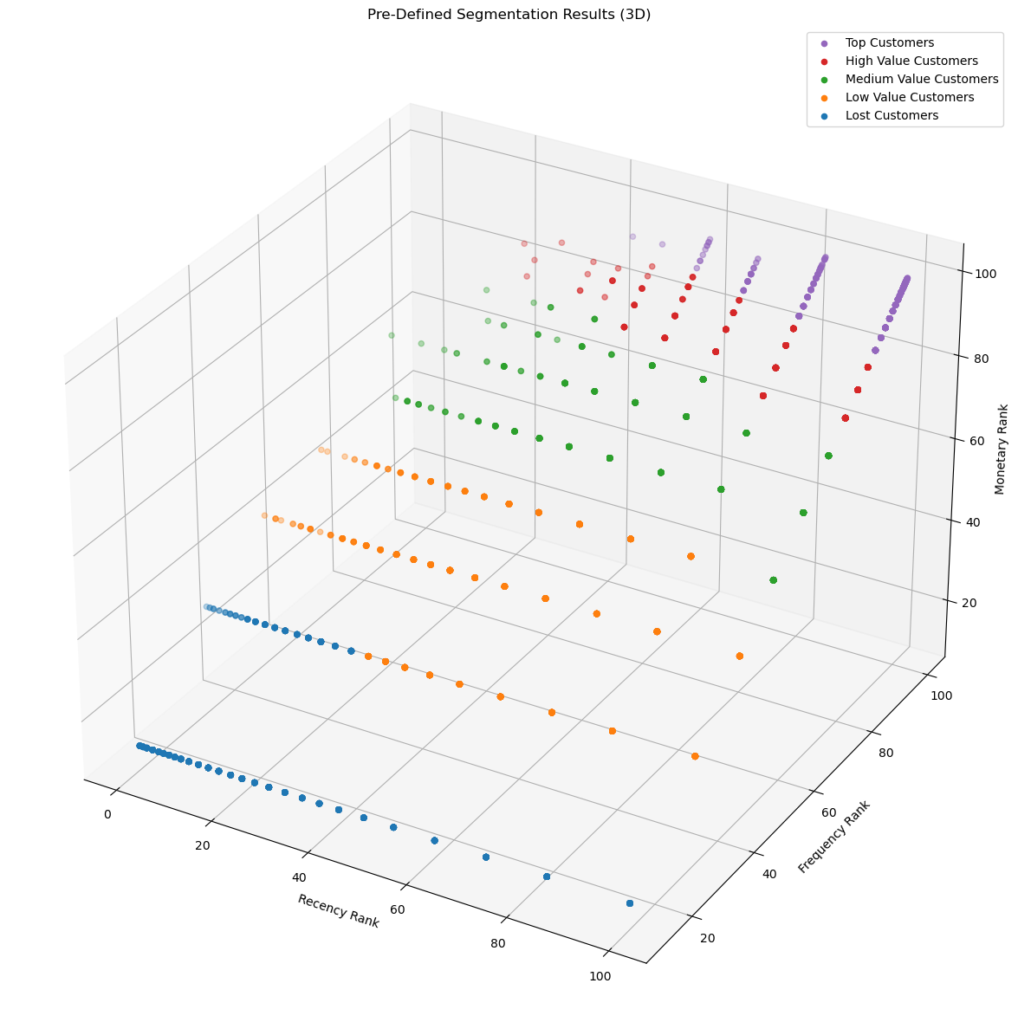
Location 1
Location 2
Notes:
Silhouette Scores of 0.33 and 0.29

Slide 13
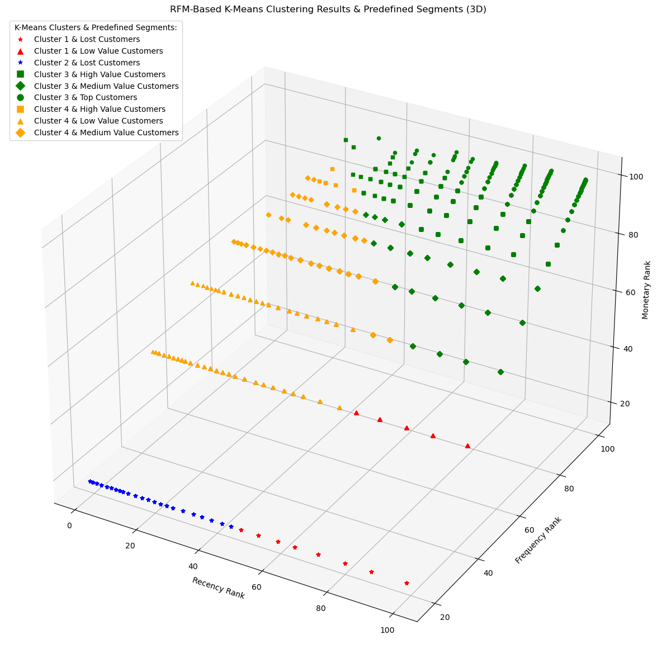
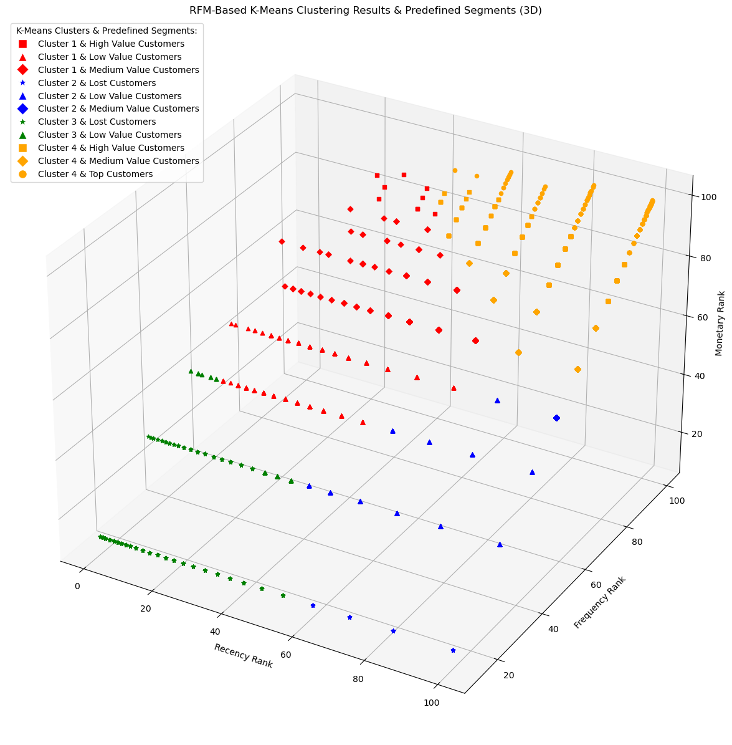
Location 1
Location 2
Cluster 1 & Cluster 2: Low Frequency, Low Expenditure, Recently Visited
Cluster 2 & Cluster 3: Lowest Frequency, Lowest Expenditure, Not Recently Visited
Cluster 3 & Cluster 4: Highest Frequency, Highest Expenditure, Recently Visited
Cluster 4 & Cluster 1: Average Frequency, High Expenditure, Not Recently Visited
Notes:
Predefined RFM Clustering with balanced RFM Score into 4 clusters had Silhouette Score of 0.40
K-Means Clustering with k=4 achieved Silhouette Score of 0.50
Our Predefined RFM Segmentation had Silhouette Score of 0.33
K-Means Algorithm Threshold between Low Value and Medium Value Customers for Location 1

Slide 14
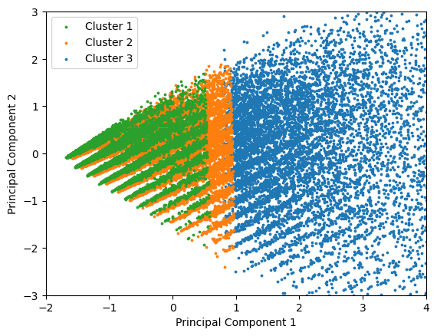
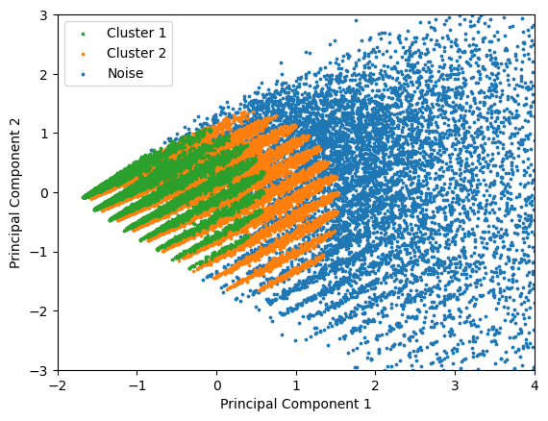
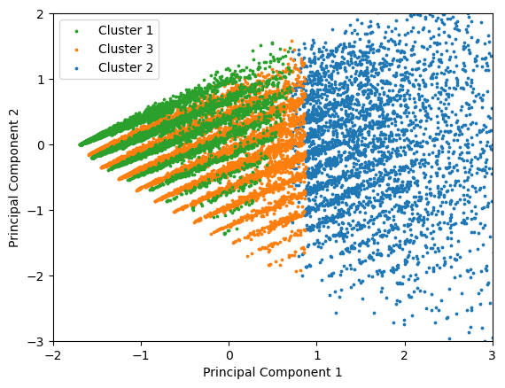
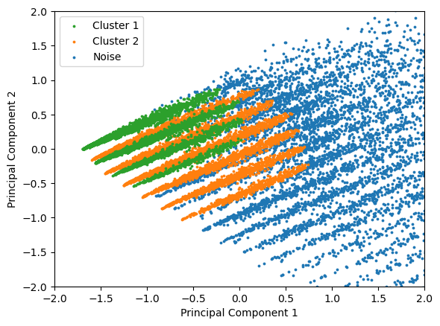
Transactional Clustering
K-Means Clustering with k=2: High & Low Expenditure Clusters
K-Means Clustering with k=3: High Expenditure Cluster, Low Expenditure Cardholder & Non-Cardholder Clusters
DBSCAN Clusters:
High Expenditure: Noise
Low Expenditure Cardholder: Orange
Low Expenditure Non-Cardholder: Green
Blue: Smallest, High Expenditure, 81% & 80% Cardholders, 72% & 71% Cardholders
Orange: Largest, Low Expenditure Cardholders, 99% & 92% Cardholders
Green: Low Expenditure Non-Cardholders, 100% & 99% Non-Cardholders
K-Means DBSCAN
Notes:
Features: Items on Offer, Total Items, Amount Spent, Cardholding Status

Slide 15
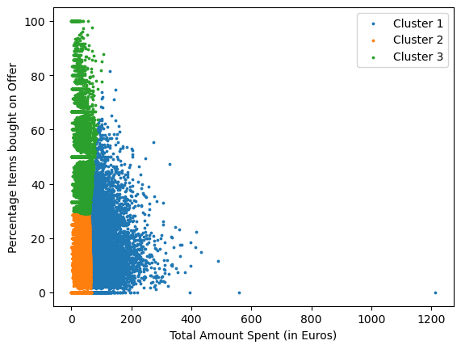
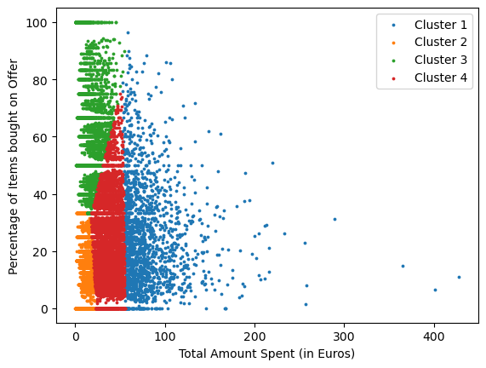
Promotional Clustering
Location 1 (64% Cardholders): 3 Clusters
Location 2 (62% Cardholders): 4 Clusters
Blue Clusters: Smallest, 80% Cardholders
% Items on Offer: 18% & 26%
Orange Clusters: Biggest, 50% Cardholders
Green Clusters: 67% & 71% Cardholders
% Items on Offer: 49% & 61%
Red Cluster: Average Shopper (71% Cardholders)
Notes:
Features: Percentage Promotions & Amount Spent
Location Average % Items on Offer: 21% & 25%

Slide 16
Table of Contents
Introduction
Exploratory Data Analysis
Customer Clustering Insights
Conclusion

Slide 17
Interpretations & Expectations
Cardholders spend more than Non-Cardholders
Women more Brand-Loyal than Men
Foot Traffic highest on the Weekends
Tuesday Anomaly
50-65 Year Olds, the most Brand-Loyal Age Group
Men prefer Weekends and Evenings to shop

Slide 18
Implications & Applications
Associating Customer Characteristics, Items, External Factors
Understanding & Categorizing Customer Behaviors
Specifically understanding Cardholding Customer Base
Increasing Cardholding Customer Base
Targeted Promotions

Slide 19

THANK YOU FOR LISTENING! PLEASE FEEL FREE TO ASK ANY QUESTIONS!

